Slide 1
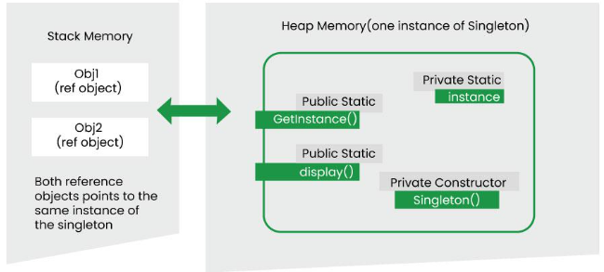

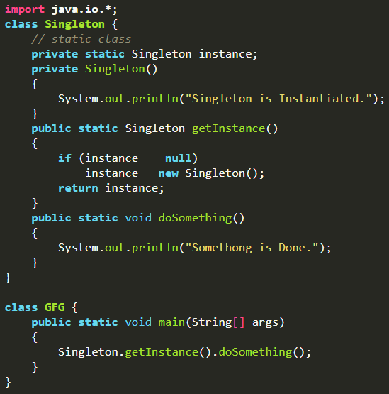
Creational Pattern – Singleton
형식 모음
글자
Software Design Pattern Communicating objects and classes Reusable solution Types → Creational Design Pattern - Abstract instantiation process - Helps make system independent of how its objects are created, composed, represented - class creational pattern uses inheritance to vary class that’s instantiated - object creational pattern will delegate instantiation to another object - Types → Singleton Pattern - Simplest design pattern - Ensure a class only has 1 instance and provides global point of access to it - When to use → Must be one instance of class and must be accessible to clients from well-know access point → When sole instance should be extensible by subclassing, clients should be able to use extended instance without modifying code → Used for logging, driver objects, caching, thread pool, DB connections, etc - Initialization Types → Early initialization: class is initialized whether it is to be used or not(drawback), initiate class at time of class loading → Lazy initialization: class is initialized only when it is required, is used when create singleton class - Key Component → Static member: ensures that memory is allocated only once, preserving single instance of Singleton class → Private Constructor: preventing that external attempt to create instances of Singleton class → Static Factory Method: providing global point of access to Singleton objects - Advantages: Solves name collision, Thread safety, Reduced memory footprint - Disadvantages: Test difficulty, Concurrency issue, Limited extensibility, Global dependency, Hard to subclass, Lifecycle
메인 내용
코드
(x₁, y₁)
(x₂, y₂)
(x_{m}, y_{m})
Result
Inside first_space
Ctrl+ = ➔ 아래첨자 Ctrl + shift + = ➔ 윗첨자 Ctrl + space ➔ 복구 Shift + f3 ➔ 대소문자 변경
예시 표시
Partition
그림 설명
예시
Code
예시
code
Mismatch
글자설명
Pattern
(-2,-2) | (-2,-1) | (-2,0) | (-2,1) | (-2,2)
(-1,-2) | (-1,-1) | (-1,0) | (-1,1) | (-1,2)
(0,-2) | (0,-1) | (x,y) | (0,1) | (0,2)
(1,-2) | (1,-1) | (1,0) | (1,1) | (1,2)
(2,-2) | (2,-1) | (2,0) | (2,1) | (2,2)
Notes:
https://www.geeksforgeeks.org/software-design-patterns/
https://www.geeksforgeeks.org/singleton-design-pattern/

Slide 2
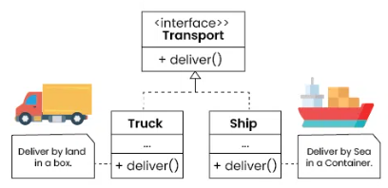
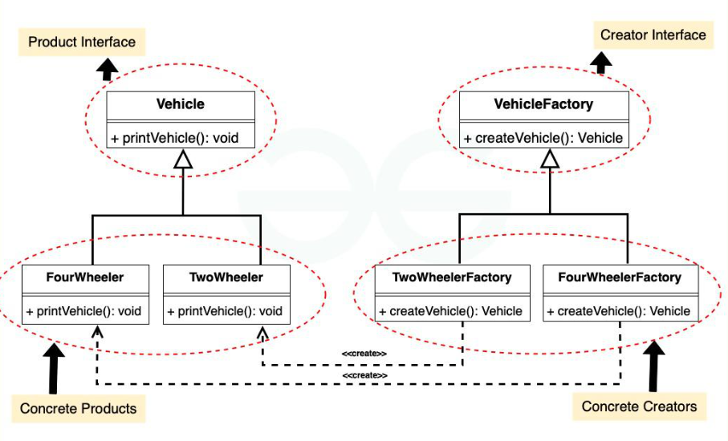

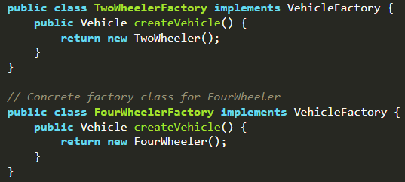
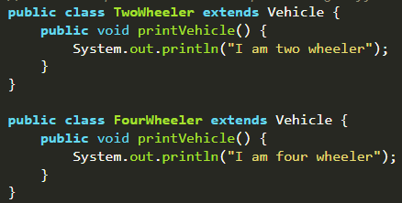

Creational Pattern – Factory Method
형식 모음
글자
→ Factory Method(Design) Pattern - Provide interface for creating objects in superclass, allowing subclasses to alter type of objects that will be created - Used to create objects without specifying exact class of object - Encapsulate object creation logic in separate method, abstracting instantiation process, promoting loose coupling - Useful when decouple creation of object from implementation - Enable flexibility, extensibility, maintainability - When to use → class can’t anticipate class of objects it must create(encapsulation object creation) → class wants its subclass to specify objects it creates → class delegate responsibility to one of several helper subclasses and we want to localized knowledge of which helper subclass is delegate → Need to support multiple product variations - Components → Creator: abstract class or interface that declares factory method(contains methods for creating object and working with created objects) → Concrete Creator: subclasses of Creator that implement factory method to create specific type of objects → Product: interface or abstract class for objects that factory method create(define common interface for all objects that factory method creates) → Concrete Product: actual objects that factory method creates(each CP class implements Product interface or extends Product abstract class) - Advantages: Decoupling, Extensibility, Testability, Reusability, Encapsulation - Disadvantage: Complexity, Overhead, Tight coupling, Dependency on Concrete subclasses,
메인 내용
코드
(x₁, y₁)
(x₂, y₂)
(x_{m}, y_{m})
Result
Inside first_space
Ctrl+ = ➔ 아래첨자 Ctrl + shift + = ➔ 윗첨자 Ctrl + space ➔ 복구 Shift + f3 ➔ 대소문자 변경
예시 표시
Partition
그림 설명
예시
Code
예시
code
Mismatch
글자설명
Pattern
(-2,-2) | (-2,-1) | (-2,0) | (-2,1) | (-2,2)
(-1,-2) | (-1,-1) | (-1,0) | (-1,1) | (-1,2)
(0,-2) | (0,-1) | (x,y) | (0,1) | (0,2)
(1,-2) | (1,-1) | (1,0) | (1,1) | (1,2)
(2,-2) | (2,-1) | (2,0) | (2,1) | (2,2)
Notes:
https://www.geeksforgeeks.org/software-design-patterns/
https://www.geeksforgeeks.org/factory-method-for-designing-pattern/

Slide 3
Creational Pattern – Abstract Factory (1)
형식 모음
글자
→ Abstract Factory Pattern - Similar to Factory pattern - work around super-factory that create other factories - Provide for creating families of related or dependent objects without specifying concrete class - At runtime, abstract factory is coupled with concrete factory which can create object of desired type - Components → Abstract factory - Defines a set of rules for creating families of related objects without specifying concrete classes - Declares a series of methods - Ensures that concrete factories adhere to common interface, providing consistent way to produce related sets of objects → Concrete factories - Implement that rules specified by abstract factory - Contains logic for creating specific instances of objects within family - Multiple concrete factories can exist, each tailored to produce distinct family of related objects → Abstract products - Represents family of related objects by defining a set of common methods or properties - Acts as abstract or interface type that all concrete products within family mush adhere to - Provides unified way for concrete products to be used interchangeably → Concrete products - Actual instances of object created by concrete factories - Implement methods declared in abstract products ensuring consistency within family and belong to category or family of related objects → Client - Utilizes abstract factory to create families of objects without specifying concrete types - Interacts with object through abstract interfaces provided by abstract products - Client enjoys flexibility of switching between families of objects by changing concrete factory instance
메인 내용
코드
(x₁, y₁)
(x₂, y₂)
(x_{m}, y_{m})
Result
Inside first_space
Ctrl+ = ➔ 아래첨자 Ctrl + shift + = ➔ 윗첨자 Ctrl + space ➔ 복구 Shift + f3 ➔ 대소문자 변경
예시 표시
Partition
그림 설명
예시
Code
예시
code
Mismatch
글자설명
Pattern
(-2,-2) | (-2,-1) | (-2,0) | (-2,1) | (-2,2)
(-1,-2) | (-1,-1) | (-1,0) | (-1,1) | (-1,2)
(0,-2) | (0,-1) | (x,y) | (0,1) | (0,2)
(1,-2) | (1,-1) | (1,0) | (1,1) | (1,2)
(2,-2) | (2,-1) | (2,0) | (2,1) | (2,2)
Notes:
https://www.geeksforgeeks.org/software-design-patterns/
https://www.geeksforgeeks.org/abstract-factory-pattern/?ref=next_article

Slide 4
Creational Pattern – Abstract Factory (2)
형식 모음
글자
- When to use → System must be independent of how its products are created, composed, represented → System must be configured with one of multiple families of products → Family of related product objects is designed to be used together and we need to enforce this constraint → Want to provide class library of products and want to reveal interfaces, not implementation → Multiple families of related products, Flexibility and extensibility, Encapsulation of creation logic, Consistency across product families - When not to use → Product families aren’t likely to change → Not dealing with multiple families of objects → Overhead(creating, maintaining multiple factories) is too high → Simpler solution is sufficient - Advantages: Isolation of concrete classes, Exchanging product families easily, Promoting consistency among products - Disadvantages: Complexity, Rigidity with new product types, Increased number of classes, Dependency inversion principle violation, Limited extensibility, Not ideal for simple systems
메인 내용
코드
(x₁, y₁)
(x₂, y₂)
(x_{m}, y_{m})
Result
Inside first_space
Ctrl+ = ➔ 아래첨자 Ctrl + shift + = ➔ 윗첨자 Ctrl + space ➔ 복구 Shift + f3 ➔ 대소문자 변경
예시 표시
Partition
그림 설명
예시
Code
예시
code
Mismatch
글자설명
Pattern
(-2,-2) | (-2,-1) | (-2,0) | (-2,1) | (-2,2)
(-1,-2) | (-1,-1) | (-1,0) | (-1,1) | (-1,2)
(0,-2) | (0,-1) | (x,y) | (0,1) | (0,2)
(1,-2) | (1,-1) | (1,0) | (1,1) | (1,2)
(2,-2) | (2,-1) | (2,0) | (2,1) | (2,2)
Notes:
https://www.geeksforgeeks.org/software-design-patterns/
https://www.geeksforgeeks.org/abstract-factory-pattern/?ref=next_article

Slide 5
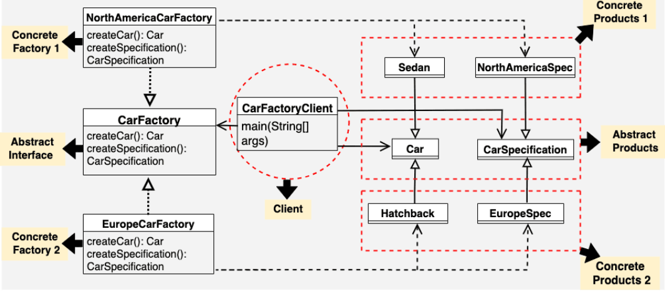
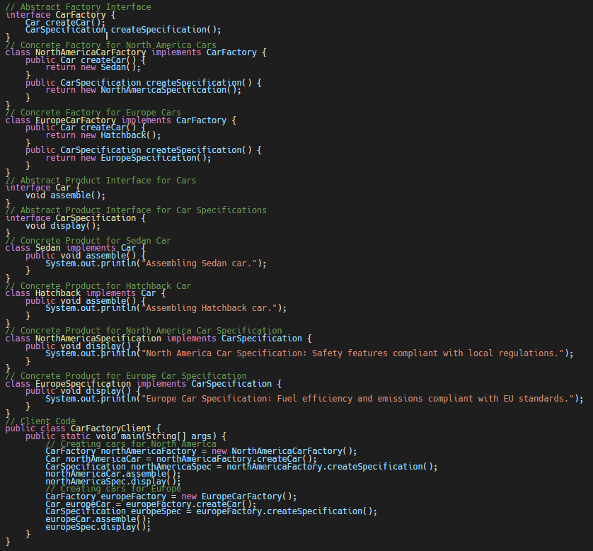
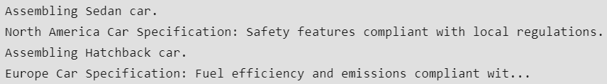
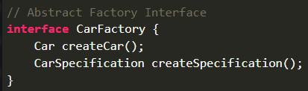
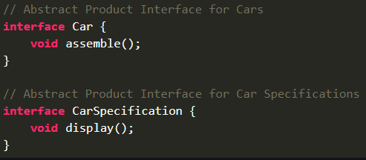
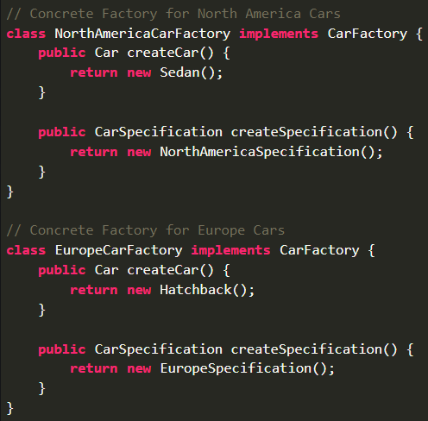
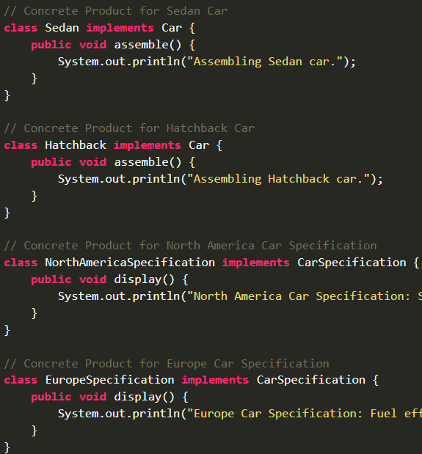
Creational Pattern – Abstract Factory (3)
형식 모음
글자
메인 내용
코드
(x₁, y₁)
(x₂, y₂)
(x_{m}, y_{m})
Result
Inside first_space
Ctrl+ = ➔ 아래첨자 Ctrl + shift + = ➔ 윗첨자 Ctrl + space ➔ 복구 Shift + f3 ➔ 대소문자 변경
예시 표시
Partition
그림 설명
예시
Code
예시
code
Mismatch
글자설명
Pattern
(-2,-2) | (-2,-1) | (-2,0) | (-2,1) | (-2,2)
(-1,-2) | (-1,-1) | (-1,0) | (-1,1) | (-1,2)
(0,-2) | (0,-1) | (x,y) | (0,1) | (0,2)
(1,-2) | (1,-1) | (1,0) | (1,1) | (1,2)
(2,-2) | (2,-1) | (2,0) | (2,1) | (2,2)
Notes:
https://www.geeksforgeeks.org/software-design-patterns/
https://www.geeksforgeeks.org/abstract-factory-pattern/?ref=next_article

Slide 6
Creational Pattern – Builder
형식 모음
글자
→ Builder Pattern - Separate construction of complex object from its representation so that same construction process can create different representations - Used to construct complex object step by step and final step will return object - When to use → Algorithm for creating complex object should be independent of parts that make up object and how they’re assembled → Construction process must allow different representations for object that’s constructed
메인 내용
코드
(x₁, y₁)
(x₂, y₂)
(x_{m}, y_{m})
Result
Inside first_space
Ctrl+ = ➔ 아래첨자 Ctrl + shift + = ➔ 윗첨자 Ctrl + space ➔ 복구 Shift + f3 ➔ 대소문자 변경
예시 표시
Partition
그림 설명
예시
Code
예시
code
Mismatch
글자설명
Pattern
(-2,-2) | (-2,-1) | (-2,0) | (-2,1) | (-2,2)
(-1,-2) | (-1,-1) | (-1,0) | (-1,1) | (-1,2)
(0,-2) | (0,-1) | (x,y) | (0,1) | (0,2)
(1,-2) | (1,-1) | (1,0) | (1,1) | (1,2)
(2,-2) | (2,-1) | (2,0) | (2,1) | (2,2)
Notes:
https://www.geeksforgeeks.org/software-design-patterns/

Slide 7
Creational Pattern – Prototype
형식 모음
글자
→ Prototype Pattern - Hide complexity of making new instances from client - Copy existing object rather than creating new instance from scratch - Specify kinds of objects to create using prototypical instance and - Existing object acts as prototype and contains state of object - When to use → When classes to instantiate are specified at run-time and create new object by copying → To avoid building class hierarchy of factory that parallels class hierarchy of products → When instances of class can have one of only different combinations of state(install corresponding number of prototypes and clone them)
메인 내용
코드
(x₁, y₁)
(x₂, y₂)
(x_{m}, y_{m})
Result
Inside first_space
Ctrl+ = ➔ 아래첨자 Ctrl + shift + = ➔ 윗첨자 Ctrl + space ➔ 복구 Shift + f3 ➔ 대소문자 변경
예시 표시
Partition
그림 설명
예시
Code
예시
code
Mismatch
글자설명
Pattern
(-2,-2) | (-2,-1) | (-2,0) | (-2,1) | (-2,2)
(-1,-2) | (-1,-1) | (-1,0) | (-1,1) | (-1,2)
(0,-2) | (0,-1) | (x,y) | (0,1) | (0,2)
(1,-2) | (1,-1) | (1,0) | (1,1) | (1,2)
(2,-2) | (2,-1) | (2,0) | (2,1) | (2,2)
Notes:
https://www.geeksforgeeks.org/software-design-patterns/

Slide 8
Structural Pattern – Adapter
형식 모음
글자
→ Structural Design Pattern - Concerned with how classes and objects are composed to from larger structures - Use inheritance to compose interface or implementation - Types → Adapter Pattern → Bridge Pattern → Composite Pattern → Decorator Pattern → Facade Pattern → Proxy Pattern → Flyweight Pattern
메인 내용
코드
(x₁, y₁)
(x₂, y₂)
(x_{m}, y_{m})
Result
Inside first_space
Ctrl+ = ➔ 아래첨자 Ctrl + shift + = ➔ 윗첨자 Ctrl + space ➔ 복구 Shift + f3 ➔ 대소문자 변경
예시 표시
Partition
그림 설명
예시
Code
예시
code
Mismatch
글자설명
Pattern
(-2,-2) | (-2,-1) | (-2,0) | (-2,1) | (-2,2)
(-1,-2) | (-1,-1) | (-1,0) | (-1,1) | (-1,2)
(0,-2) | (0,-1) | (x,y) | (0,1) | (0,2)
(1,-2) | (1,-1) | (1,0) | (1,1) | (1,2)
(2,-2) | (2,-1) | (2,0) | (2,1) | (2,2)
Notes:
https://www.geeksforgeeks.org/software-design-patterns/

Slide 9
Behavioral Pattern – Observer
형식 모음
글자
→ Behavioral Design Pattern - Concerned with algorithm and assignment of responsibilities between objects - Describe pattern of objects or classes and pattern of communication between them - Characterize complex control flow that is difficult to follow at run-time - Types → Observer Pattern → Strategy Pattern → State Pattern → Command Pattern → Chain of Responsibility → Template Pattern → Interpreter Pattern → Visitor Pattern → Mediator Pattern → Memento Pattern
메인 내용
코드
(x₁, y₁)
(x₂, y₂)
(x_{m}, y_{m})
Result
Inside first_space
Ctrl+ = ➔ 아래첨자 Ctrl + shift + = ➔ 윗첨자 Ctrl + space ➔ 복구 Shift + f3 ➔ 대소문자 변경
예시 표시
Partition
그림 설명
예시
Code
예시
code
Mismatch
글자설명
Pattern
(-2,-2) | (-2,-1) | (-2,0) | (-2,1) | (-2,2)
(-1,-2) | (-1,-1) | (-1,0) | (-1,1) | (-1,2)
(0,-2) | (0,-1) | (x,y) | (0,1) | (0,2)
(1,-2) | (1,-1) | (1,0) | (1,1) | (1,2)
(2,-2) | (2,-1) | (2,0) | (2,1) | (2,2)
Notes:
https://www.geeksforgeeks.org/software-design-patterns/

